Slide 1
Troubleshooting Mobile Connectivity Problems
Lesson 4

Slide 2
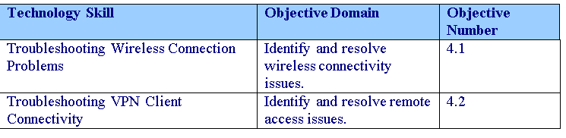
Objectives
Notes:
Outline the material you are going to cover in this lesson. Do not go into detail; each of these points will be expanded on in the lesson. You may also want to mention the Technology Skills that are being covered for the Certification exam.

Slide 3
Wireless Networks
Most wireless networks used by companies are 802.11b, 802.11g, or 802.11n networks.
Wireless devices that are based on these specifications can be Wi-Fi certified to show they have been thoroughly tested for performance and compatibility.

Slide 4
Wireless Networks
802.11b was the first widely accepted wireless technology, followed by 802.11g and 802.11n.
As a general rule, devices supporting the newer, faster standards are capable of falling back to slower speeds when necessary.
It should be noted that 802.11a is not compatible with 802.11b because each use different frequencies and modulation techniques; although, some network adapters may support both 802.11a and 802.11b.

Slide 5
Wireless Networks
The 802.11 workgroup currently documents use in three distinct frequency ranges, 2.4 GHz, 3.6 GHz, and 4.9/5.0 GHz bands.
Each range is divided into a multitude of channels.
There are 14 channels designated in the 2.4 GHz range spaced 5 MHz apart (with the exception of a 12 MHz spacing before Channel 14).
Consequently, using only channels 1, 6, 11, and 14 is recommended to avoid interference.

Slide 6
Wireless Operating Modes
Wireless adapters can run in one of two operating modes:
Independent basic service set (IBSS)
Also known as ad hoc, where hosts connect directly to other computers with wireless adapters.
Extended service set (ESS)
Also known as infrastructure, where hosts connects to a wireless access point using a wireless adapter.

Slide 7
Wired Equivalent Privacy (WEP)
The first widely used encryption algorithm used on wireless networks is Wired Equivalent Privacy (WEP).
While WEP was intended to provide confidentiality comparable to that of a traditional wired network, WEP was easily cracked with readily available software within minutes.
Therefore, it is recommended that you use WPA or WPA2.

Slide 8
WPA and WPA2
Within a few months after the security weaknesses were identified with WEP, IEEE created Wi-Fi Protected Access (WPA) as an interim standard prior to the ratification of 802.11i followed by WPA2.
WPA provides strong data encryption via Temporal Key Integrity Protocol (TKIP), while Wi-Fi Protected Access 2 (WPA2) provides enhanced data encryption via Advanced Encryption Standard (AES)
To help prevent someone from hacking the key, WPA and WPA2 rotate the keys and change the way keys are derived.

Slide 9
Personal Mode
Both WPA and WPA2 can run in both personal and enterprise mode.
Personal mode, designed for home and small office networks, provides authentication via a pre-shared key or password.
The session keys are then changed often and handled in the background.

Slide 10
Enterprise Mode
Enterprise mode provides authentication using IEEE 802.1X and Extensible Authentication Protocol (EAP).
802.1X provides an authentication framework for wireless LANs, allowing a user to be authenticated by a central authority such as a RADIUS server.
Enterprise mode uses two sets of keys: the session keys and group keys.
Both sets of keys are generated dynamically and are rotated to help safeguard the integrity of keys over time.
The encryption keys could be supplied through a certificate or smart card.

Slide 11
Configuring Wireless Adapters
802.11 wireless networks are identified by the service set identifier, or SSID, which is often broadcasted for all to see.
When running Windows 7, the network can be seen in the networking notification icon in the system tray.
If the SSID is not broadcasted, you will have to enter the SSID manually.
The SSID can be up to 32 characters long.

Slide 12
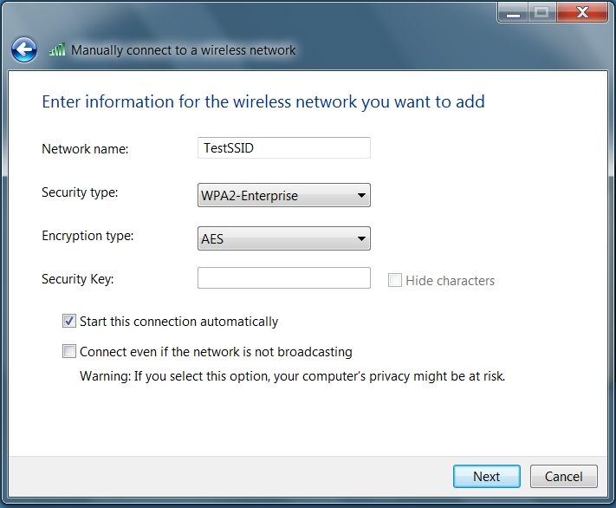
Configuring Wireless Adapters

Slide 13
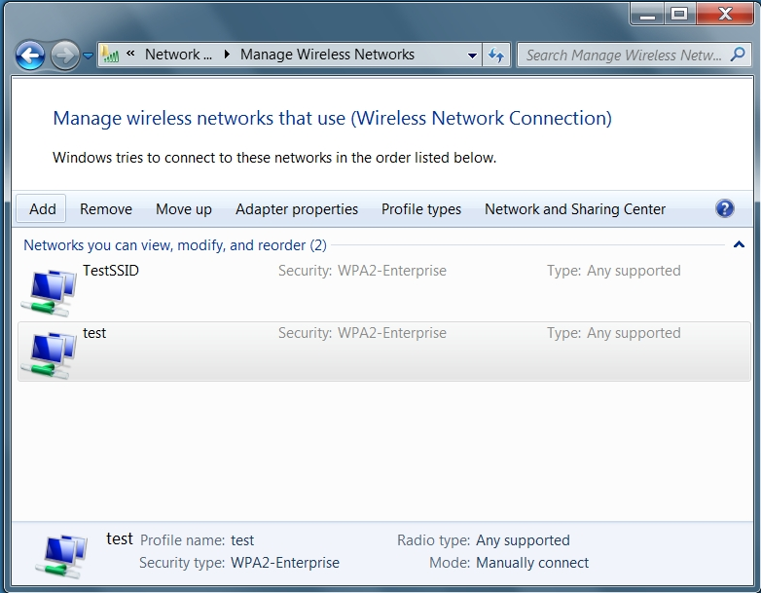
Configuring Wireless Adapters

Slide 14
Using Group Policies and Scripts
You can also configure wireless networks using Group Policies or scripts.
If you use group policies, you can configure a client to automatically connect to your organization’s wireless network and keep the computer from connecting to other wireless networks.
You can also use the netsh command and carry the configuration information using USB flash drives.

Slide 15
Bootstrap Wireless Profile
When a computer running Windows 7 joins a domain over a wireless network, it uses a single sign on to use the same credentials to join a wireless network as the domain.
A bootstrap wireless profile can be created on the wireless client, which first authenticates the computer to the wireless network and then connects to the network and attempts to authenticate to the domain.
Authentication can be done either by using a username and password combination or security certificates from a public key infrastructure (PKI).

Slide 16
Troubleshooting Wireless Connection Problems
If your network adapter cannot see any wireless networks, you should make sure:
The wireless device is on.
The wireless device is enabled in the Network and Sharing Center.
The correct wireless device driver is installed and enabled.
You can check to make sure the wireless device is on because most of today’s laptops have on/off switches or buttons so that you can quickly turn the wireless device on or off.

Slide 17
Signal Strength
As wireless networks have become common, so have problems with signal strength.
The farther you are from a wireless access point, the weaker the signal will be.
Since the signal is weaker, you will usually have slower network performance.
Notes:
To view your network signal strength, you can open Network and Sharing Center, click Change adapter settings, right-click the wireless device, and select Status.

Slide 18
Signal Strength
If your wireless network connection drops frequently or you suffer from poor performance, you should:
Check to make sure the wireless access point and wireless device are transmitting at maximum power.
Try to move closer to the access point or move the access point closer to the client computer.
Try adjusting the antennas or replace the antenna of the wireless access point to a high-gain antenna.

Slide 19
Connectivity Problems
If you cannot connect to a wireless network but you could before, you should verify the wireless profile to make sure the correct settings are being used including the encryption algorithm and the key.
You should also verify that the access point is powered on and working properly and that you have sufficient signal strength.
If you maintain steady signal strength and have intermittent connections, you should check for interference from another device that transmits on the same frequency as your wireless network

Slide 20
Remote Access
Today, it is very common for an organization to use remote access server (RAS), which enables users to connect remotely using various protocols and connection types.
Virtual private network (VPN) links two computers through a wide-area network such as the Internet.
To keep the connection secure, the data sent between the two computers is encapsulated and encrypted.

Slide 21
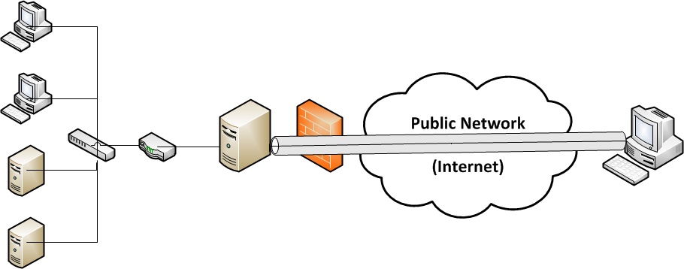
VPN Connection

Slide 22
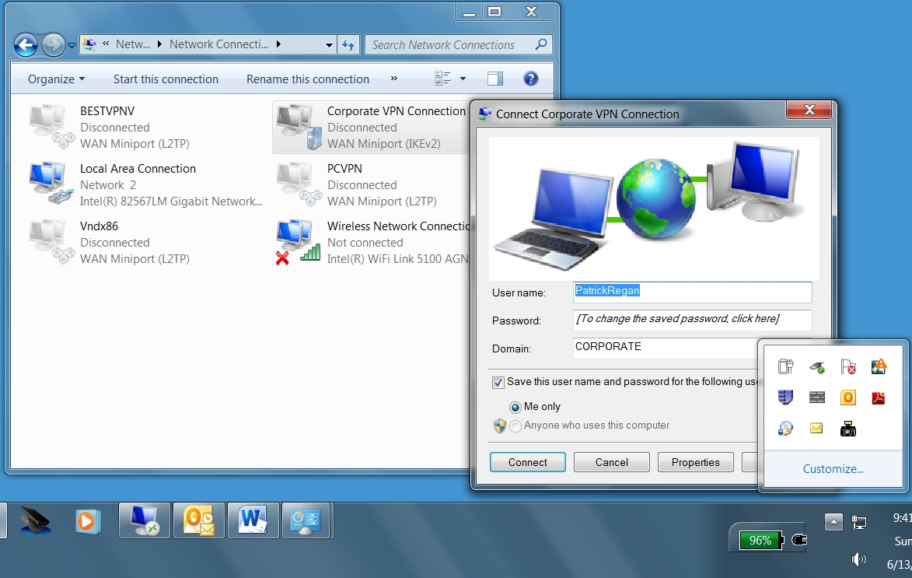
VPN Connection

Slide 23
VPN Connection
The VPN server in a Windows VPN infrastructure runs Routing and Remote Access Server (RRAS), which in Windows Server 2008 is the Network Policy and Access Service server role.
Servers configured with RRAS can receive requests from remote access users located on the Internet, authenticate these users, authorize the connection requests, and finally either block the requests or route the connections to private internal network segments.

Slide 24
VPN Connection
The five types of tunneling protocols used with a VPN server/RAS server running on Windows Server 2008 and Windows 7 include:
Point-to-Point Tunneling Protocol (PPTP)
Internet Protocol Security (IPSec)
Layer 2 Tunneling Protocol (L2TP)
Internet Key Exchange version 2 (IKEv2)
Secure Socket Tunneling Protocol (SSTP)

Slide 25
Point-to-Point Tunneling Protocol (PPTP)
Based on the legacy Point-to-Point protocol used with modems. Unfortunately, PPTP is easy to set up but is considered to use weak encryption technology.

Slide 26
Internet Protocol Security (IPSec)
A protocol suite for securing Internet Protocol (IP) communications by authenticating and encrypting each IP packet of a data stream.
IPSec also includes protocols for establishing mutual authentication between agents at the beginning of the session and negotiation of cryptographic keys to be used during the session.
IPSec can be used to protect data flows between a pair of hosts or between a security gateway and a host.

Slide 27
Layer 2 Tunneling Protocol (L2TP)
Used with IPSec to provide security and is the industry standard when setting up secure tunnels.
Since all clients must be authenticated, a user must connect with either a computer certificate or a preshared key.
Another drawback with L2TP/IPSec is that it does not natively support the traversal of NAT devices.
However, you can enable L2TP/IPSec to cross a NAT device by changing a registry value.

Slide 28
Internet Key Exchange version 2 (IKEv2)
New in Windows 7 and Windows Server 2008 R2.
It uses IPSec for encryption while supporting VPN Reconnect (also called Mobility), which enables VPN connections to be maintained when a VPN client moves between wireless cells or switches and to automatically reestablish broken VPN connectivity.
Different from L2TP with IPSec, IKEv2 client computers do not need to provide authentication through a machine certificate or a preshared key.

Slide 29
Secure Socket Tunneling Protocol (SSTP)
Also introduced with Windows Server 2008,
Uses HTTPS protocol over TCP port 443 to pass traffic through firewalls and web proxies that might block PPTP and L2TP/IPSec without requiring a client computer certificates or preshared key.

Slide 30
RADIUS
For authentication, RRAS can be configured to forward the authentication request to a RADIUS/Network Policy Server (NPS) server or to use Windows authentication (domain or SAM).
RADIUS, short for Remote Authentication Dial In User Service, is a networking protocol that provides centralized authentication, authorization, and accounting (AAA) management for computers to connect and use a network service.

Slide 31
VPN Authentication
Password Authentication Protocol (PAP): Uses plain text (unencrypted passwords). PAP is the least secure authentication and is not recommended.
Challenge Handshake Authentication Protocol (CHAP): A challenge-response authentication that uses the industry standard md5 hashing scheme to encrypt the response. CHAP was an industry standard for years and is still quite popular.

Slide 32
VPN Authentication
Microsoft CHAP version 2 (MS-CHAP v2): Provides two-way authentication (mutual authentication). MS-CHAP v2 provides stronger security than CHAP.
Extensible Authentication Protocol (EAP-MS-CHAPv2): A universal authentication framework that allows third-party vendors to develop custom authentication schemes including retinal scans, voice recognition, fingerprint identifications, smart card, Kerberos, and digital certificates. It also provides mutual authentication methods that support password-based user or computer authentication.

Slide 33
Split Tunneling
When connecting through a VPN, by default the “Use Default Gateway on the Remote Network” option is enabled.
As a result, a new default route is created on the VPN client, which forwards data that cannot be sent to the local network to the VPN connection.

Slide 34
Split Tunneling
Enabling this option helps protect the corporate network because all traffic will also go through firewalls and proxy servers to help prevent a network from being infected or compromised.
When you disable the “Use Default Gateway on Remote Network” option, you are using a split tunnel.

Slide 35
Troubleshooting VPN Connection
When troubleshooting VPN client connectivity issues you should:
Make sure that the client computer can connect to the Internet.
Verify the VPN client connection has the correct server name or IP address. If the connection specification uses the server name, you will need to verify that the server name resolves to the correct IP address.
Verify that the user has the correct digital certificate and that the digital certificate is valid.

Slide 36
Troubleshooting VPN Connection
Make sure that the user is using the proper user credentials including the domain name if necessary.
Verify the user is authorized for remote access by checking the user properties or by checking the network policies.
Verify that the correct authentication and encryption methods are selected, especially if you receive a 741/742 encryption mismatch error.

Slide 37
Troubleshooting VPN Connection
If you are using LT2P with IPSec going through a NAT device, you need to make sure that you have the proper registry settings.
If you are using any type of firewall and any type of security control software, make sure that the firewall is configured to allow the VPN connection.
Verify that you have enough PPTP or L2TP ports available to handle the new connection.

Slide 38
Troubleshooting VPN Connection
Once you are connected, you may have some other problems relating to your VPN connection (mostly configured on the VPN server).
Verify that routing is configured properly by pinging a remote host through the VPN.
Verify that you have the proper name resolution for internal resources.
Verify that the VPN connection has the proper IP configuration including that there are enough DHCP addresses available.

Slide 39
DirectAccess
DirectAccess is a new feature introduced with Windows 7 and Windows Server 2008 R2 that provides seamless intranet connectivity to DirectAccess client computers when they are connected to the Internet.
Different from the traditional VPN connections, DirectAccess connections are automatically established.

Slide 40
DirectAccess
DirectAccess overcomes the limitations of VPNs by automatically establishing a bi-directional connection from client computers to the corporate network using IPSec and Internet Protocol version 6 (IPv6).
As a result, remote client computers are automatically connected to the corporation’ network so that they can be easily managed including kept up-to-date with critical updates and configuration changes.

Slide 41
DirectAccess
One or more DirectAccess server running Windows Server 2008 R2 with two network adapters: one that is connected directly to the Internet and one that is connected to the intranet.
In addition, DirectAccess servers must be a member of an AD DS domain.
DirectAccess client computers that are running Windows 7 Enterprise or Windows 7 Ultimate. DirectAccess clients must be members of an AD DS domain.

Slide 42
DirectAccess
On the DirectAccess server, at least two consecutive, public IPv4 addresses assigned to the network adapter that is connected to the Internet.
At least one domain controller and DNS server that is running Windows Server 2003 SP2 or Windows Server 2008 R2.
When Forefront Unified Access Gateway (UAG) is used, DirectAccess can be deployed with DNS servers and domain controllers that are running Windows Server 2003 when NAT64 functionality is enabled.

Slide 43
DirectAccess
A public key infrastructure (PKI) to issue computer certificates, and optionally, smart card certificates for smart card authentication and health certificates for NAP.
Without UAG, an optional NAT64 device to provide access to IPv4-only resources for DirectAccess clients. DirectAccess with UAG provides a built-in NAT64.

Slide 44
Skill Summary
When you purchase laptop computers today, they will most likely come with wireless card to connect to an 802.11 network.
802.11 is a set of standards carrying out wireless local area network (WLAN) computer communication in the 2.4, 3.6, and 5 GHz frequency bands.
802.11b was the first widely accepted wireless technology, followed by 802.11g and 802.11n.

Slide 45
Skill Summary
It should be noted that 802.11a is not compatible with 802.11b because each use different frequencies and modulation techniques; although, some network adapters may support both 802.11a and 802.11b.
Wireless adapters can run in one of two operating modes: Independent basic service set (IBSS) and Extended service set (ESS).
Independent basic service set (IBSS), also known as ad hoc, has hosts connect directly to other computers with wireless adapters.
Notes:
Review the Skill Summary to wrap up your lesson.

Slide 46
Skill Summary
Extended service set (ESS), also known as infrastructure, has a host connect to a wireless access point using a wireless adapter.
Since wire technology sends radio waves out into the open, wireless network signals can be captured by anyone within the range of the antennas. Therefore, you will need to implement encryption and other security measures to prevent the reading of the data sent over the wireless technology.

Slide 47
Skill Summary
The first widely encryption algorithm used on wireless networks is Wired Equivalent Privacy (WEP), which was intended to provide confidentiality comparable to that of a traditional wired network.
Unfortunately, WEP was easily cracked with readily available software within minutes. Therefore, it is recommended to use WPA or WPA2.

Slide 48
Skill Summary
IEEE created Wi-Fi Protected Access (WPA) as an interim standard prior to the ratification of 802.11i, which provides strong data encryption via Temporal Key Integrity Protocol (TKIP).
WPA2 provides enhanced data encryption via Advanced Encryption Standard (AES), which meets the Federal Information Standard (FIPS) 140-2 requirement of some government agencies.
To help prevent someone from hacking the key, WPA and WPA2 rotate the keys and change the way keys are derived.

Slide 49
Skill Summary
802.1X provides an authentication framework for wireless LANs, allowing a user to be authenticated by a central authority such as a RADIUS server.
Both WPA and WPA2 can run in both personal and enterprise mode.
Personal mode, designed for home and small office networks, provides authentication via a pre-shared key or password.
Enterprise mode provides authentication using IEEE 802.1X and Extensible Authentication Protocol (EAP). The encryption key could be supplied through a certificate or smart card.

Slide 50
Skill Summary
802.11 wireless networks are identified by the service set identifier, or SSID, which are often broadcast for all to see.
For better security, it is recommended that you do not broadcast the SSID.
You can also configure wireless networks using Group Policies, scripts, or a USB flash drive.

Slide 51
Skill Summary
A bootstrap wireless profile can be created on the wireless client, which first authenticates the computer to the wireless network and then connects to the network and attempts to authenticate to the domain
If your network adapter cannot see any wireless networks, you need to check is whether the wireless device is on, is enabled, and that the correct wireless device is installed.
The farther away you get from a wireless access point, the weaker the signal will be, which also results in slower network performance.

Slide 52
Skill Summary
If you cannot connect to a wireless network that you could before, it would make sense to check the security settings to make sure the settings within wireless profile including the any keys.
If you have an intermittent connection to your wireless network, it is most likely caused by interference with another device that transmits on the same frequency as your wireless network.
Today, it is very common for an organization to use remote access server (RAS), which allows users to connect remotely using various protocols and connection types.

Slide 53
Skill Summary
Virtual private network (VPN) links two computers through a wide-area network such as the Internet. To keep the connection secure, the data sent between the two computers is encapsulated and encrypted.
The four types of tunneling protocols used with a VPN server/RAS server running on Windows Server 2008 and Windows 7 include: Point-to-Point Tunneling Protocol (PPTP), Layer 2 Tunneling Protocol (L2TP), Internet Key Exchange version 2 (IKEv2), and Tunneling Protocol (SSTP).

Slide 54
Skill Summary
Point-to-Point Tunneling Protocol (PPTP) is based on the legacy Point-to-Point protocol used with modems. Unfortunately, PPTP is easy to set up but uses a weak encryption technology.
Internet Protocol Security (IPSec) is a protocol suite for securing Internet Protocol (IP) communications by authenticating and encrypting each IP packet of a data stream.
Layer 2 Tunneling Protocol is used with IPSec to provide security and is the industry standard when setting up secure tunnels. Since all clients must be authenticated, a user must connect with either a computer certificate or a preshared key.

Slide 55
Skill Summary
IKEv2, short for Internet Key Exchange version 2, uses IPSec for encryption while supporting VPN Reconnect (also called Mobility), which enables VPN connections to be maintained when a VPN client moves between wireless cells or switches.
Unlike L2TP with IPSec, IKEv2 client computers do not need to provide authentication through a machine certificate or a preshared key.

Slide 56
Skill Summary
Secure Socket Tunneling Protocol (SSTP) uses HTTPS protocol over TCP port 443 to pass traffic through firewalls and web proxies that might block PPTP and L2TP/IPSec without requiring client computer certificates or a preshared key.
RADIUS, short for Remote Authentication Dial In User Service, is a networking protocol that provides centralized authentication, authorization, and accounting (AAA) management for computers to connect and use a network service.

Slide 57
Skill Summary
When using VPNs, Windows 7 and Windows Server 2008 support the following forms of authentication: Password Authentication Protocol (PAP), Challenge Handshake Authentication Protocol (CHAP), Microsoft CHAP version 2 (MS-CHAP v2), and Extensible Authentication Protocol (EAP-MS-CHAPv2).
When connecting through a VPN, by default, the “Use Default Gateway on the Remote Network” option is enabled. As a result, a new default route is created on the VPN client, which makes data that cannot be sent to the local network forwarded to the VPN connection.

Slide 58
Skill Summary
When troubleshooting VPN client connectivity issues make sure that the client computer can connect to the Internet; you have the correct digital certificates; you are using the correct authentication, encryption, and the proper user credentials.
If you are using LT2P with IPSec going through a NAT device, you need to make sure that you have the proper registry settings.

Slide 59
Skill Summary
DirectAccess is a new feature introduced with Windows 7 and Windows Server 2008 R2 that provides seamless intranet connectivity to DirectAccess client computers when they are connected to the Internet.
DirectAccess overcomes the limitations of VPNs by automatically establishing a bi-directional connection from client computers to the corporate network using IPSec and Internet Protocol version 6 (IPv6).

Slide 60
Skill Summary
If a native IPv6 network is not available (and it probably will not be when the computer is connected to the Internet), the client uses 6 to 4 or Teredo to send IPv4-encapsulated IPv6 traffic.
The Direct Access client must have a global IPv6 address, which should begin with a 2 or 3.

